Slide 1
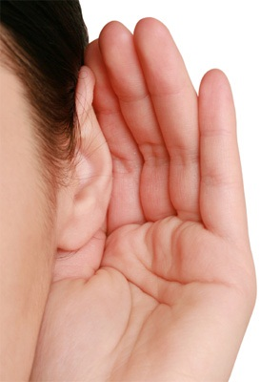
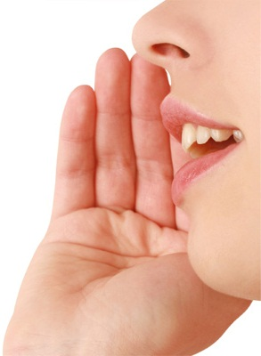
WHAT IS COMMUNICATION ???

Slide 2
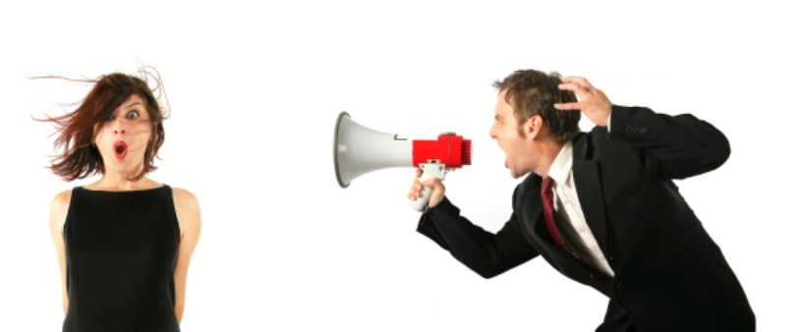
COMMUNICATION IS THE ART OF TRANSMITTING KNOWLEDGE, IDEAS, INFORMATION AND THOUGHTS
FROM ONE PERSON TO ANOTHER.
THE TRANSFER SHOULD BE SUCH THAT
THE RECIEVER UNDERSTANDS
THE MEANING AND THE INTENT OF THE MESSAGE
AND GIVE PROPER FEEDBACK

Slide 3
★★★ IMPORTANCE ★★★
Necessary for planning
Understanding each other
Establishment of effective leadership
Increases Efficiency
Basis of Decision-making
Smooth Working of Enterprise
Motivation
Co-ordination

Slide 4


BARRIERS
There are three levels at which communication takes place
Noticing is done with the senses, and is at the physical level
Understanding is at the level of intelligence
Acceptance is at the emotional level
Anything that hinders the process of communication at any of these levels is a barrier to communication
Barriers to communication can be defined as the aspects or conditions that interfere with effective exchange of ideas or thoughts.

Slide 5
FACTORS
  Environmental
  Technological
  Organizational
  Jargons
  External Noise
  Emotions
  Distance
  Personal Interests
  Misinterpretation
  Fear
  Stress
  Status
  Chain of command
  Trust Issues
  Negative Self Image

Slide 6
CLASSIFICATION OF BARRIERS
PHYSICAL BARRIERS
SEMANTIC AND LANGUAGE BARRIERS
SOCIO-PSYCHOLOGICAL BARRIERS
ORGANIZATIONAL BARRIERS
CROSS-CULTURAL BARRIERS

Slide 7

PHYSICAL BARRIERS

Slide 8
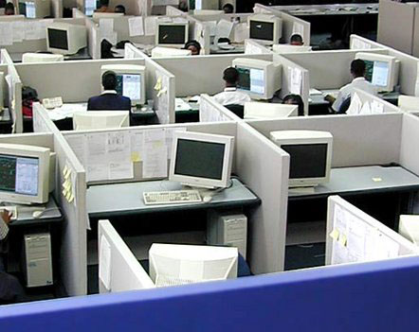
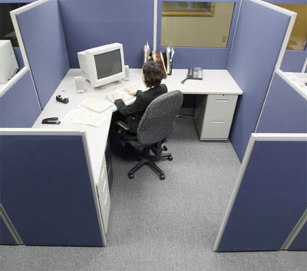
Faulty Organizational Structure
Large working area
Closed office doors
Separate areas for people of different status
It forbids team member from effective interaction with each other.

Slide 9
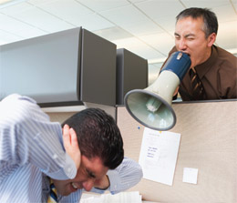

Noise
Physical noise (outside disturbance)
Psychological noise (inattentiveness)
Written noise (bad handwriting/typing)
Visual noise (late arrival of employees)

Slide 10
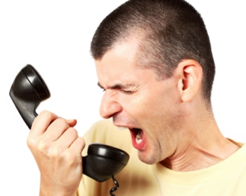
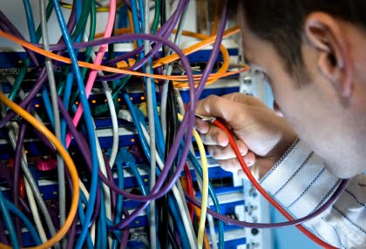
Time and Distance
Improper Time
Defects in Medium of communication
Network Facilities
Mechanical Breakdowns

Slide 11

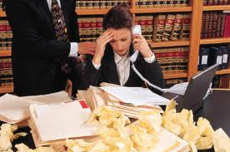
Information Overload
Piling up of tasks due to improper time management.
Excess number of people assigned for same task
Work overload/Information duplication.

Slide 12

SEMANTIC & LANGUAGE
BARRIERS
Those who speak do not know
Those who know do not speak
- Random Japanese Guy

Slide 13
SEMANTICS
What do you mean by SEMANTICS?
Why is SEMANTICS required?
When does SEMANTIC BARRIER arises?

Slide 14


SIMILAR SOUNDING WORDS
These words are known as Homophones
Pronunciation
Spelling
Meaning
Examples:
pale/pail
alter/altar
buy/bye/by
rain/reign

Slide 15
WORDS HAVE MULTIPLE PRONUNCIATIONS
These words are known as Homographs
Spelling
Pronunciation
Meaning
Examples
The bandage was wound around the wound.
We must polish the Polish furniture.
He could lead if he would get the lead out.

Slide 16
WORDS HAVE MULTIPLE MEANING
These Words are also known as homonyms
Spelling
Pronunciation
Meaning
Examples
Never desert your friends in the desert.
Close the window before the bee gets too close

Slide 17
DENOTATIONS AND CONNOTATIONS
Denotation: The literal meaning of a word
Connotaions: The emotions and associations connected to a word
  Favourable Connotation: 'honest', 'noble', 'sincere’
  Unfavourable Connotation: 'cowardly', 'slow', 'incompetent‘
Examples:
They gave us cheap stuff.
At this shop, they sell things cheap

Slide 18

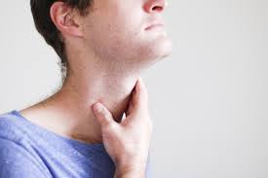
LANGUAGE BARRIERS
Different Languages
No Clarity in Speech

Slide 19
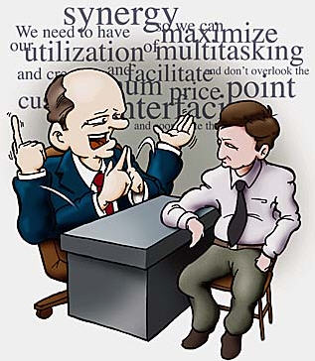

LANGUAGE BARRIERS
Using Jargons
Not being specific

Slide 20
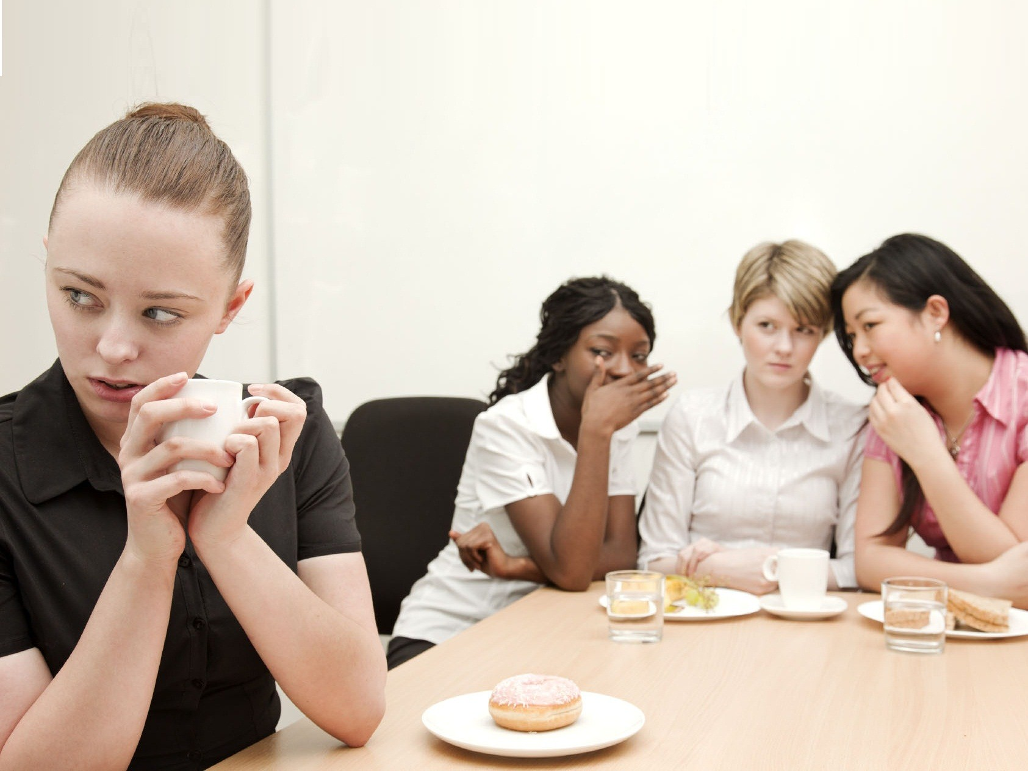
SOCIO-PSYCHOLOGICAL BARRIERS

Slide 21

What is Pyschological barrier?
Psychological barriers can be described as the cause of distorted communication because of human psychology problems.

Slide 22
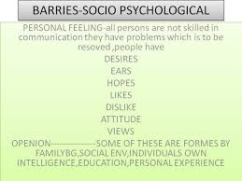
Psychological barriers
Attitude and opinions:
Emotions
Filtering and distortion of message
Status difference
In attention
Closed mind
Fields of experience

Slide 23
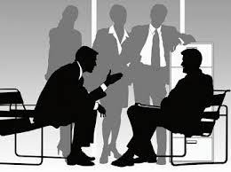
Others include:
Group identification
Self-image
Premature evaluation
Distrust
Poor retention

Slide 24

CROSS-CULTURAL BARRIERS

Slide 25


Slide 26
Cross Culture Communication
Meaning of Cross Culture Communication
Understanding different cultures facilitates Cross Culture Communication
Components of Cross Culture Communication

Slide 27


Different Cross Cultural Barrier
Language
Values

Slide 28

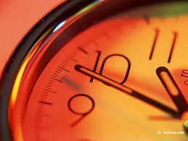
Different Cross Cultural Barrier
Social Relation
Concept of time

Slide 29


Different Cross Cultural Barrier
Concept of space
Gestures

Slide 30
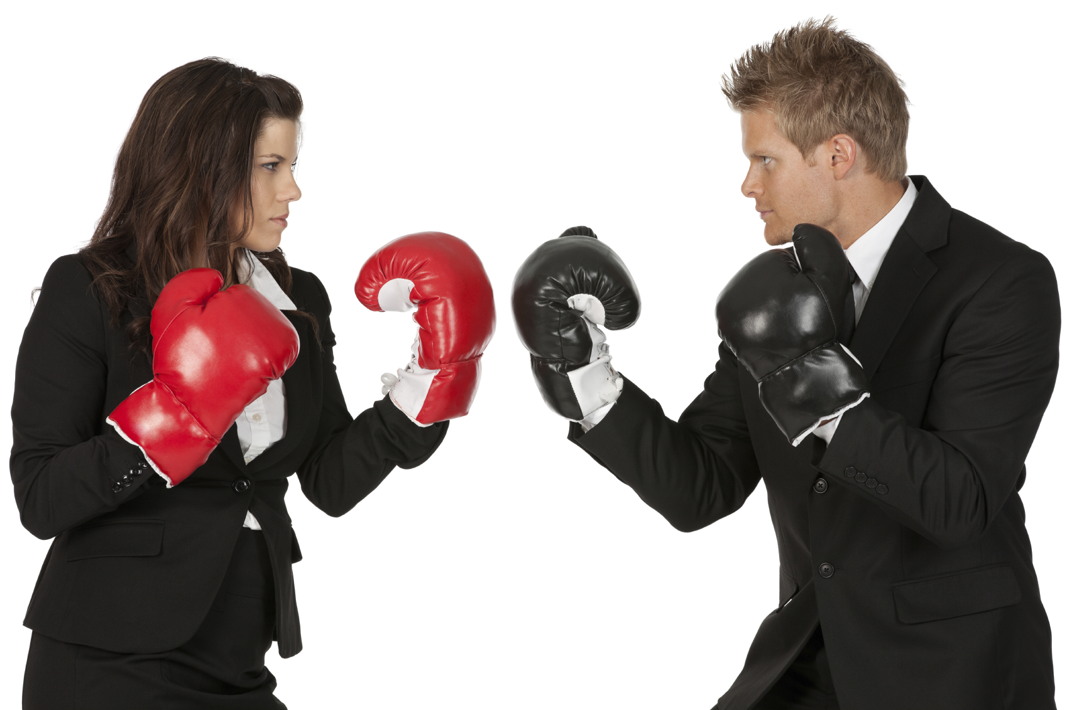
ORGANISATIONAL BARRIERS

Slide 31
Organizational barriers
Loss or distortion of messages as they pass from one level to another
Filtering of information according to one’s understanding/interpretation
Messages not read completely or not understood correctly
Deliberate withholding of information from peers perceived as rivals
Information gap if upper level does not know the true state of affairs
Notes:
rate

Slide 32
….cont
Lack of communication policy
Authoritarian attitude of management
Poorly Defined Authority and Responsibility
Too Many Levels in Organization Structure
Insufficient Communication Training

Slide 33
Overcoming Communication Barriers
Individual Skills
Active listening
Select the appropriate channel for the message
Make a special effort to understand each other's perspective
Managers should practice MBWA.

Slide 34
Overcoming Communication Barriers
Organizational Actions
Create a climate of trust and openness
Develop and use formal information channels in all directions
Encourage the use of multiple channels including formal and informal communications
The organizational structure should fit communication needs.

Slide 35
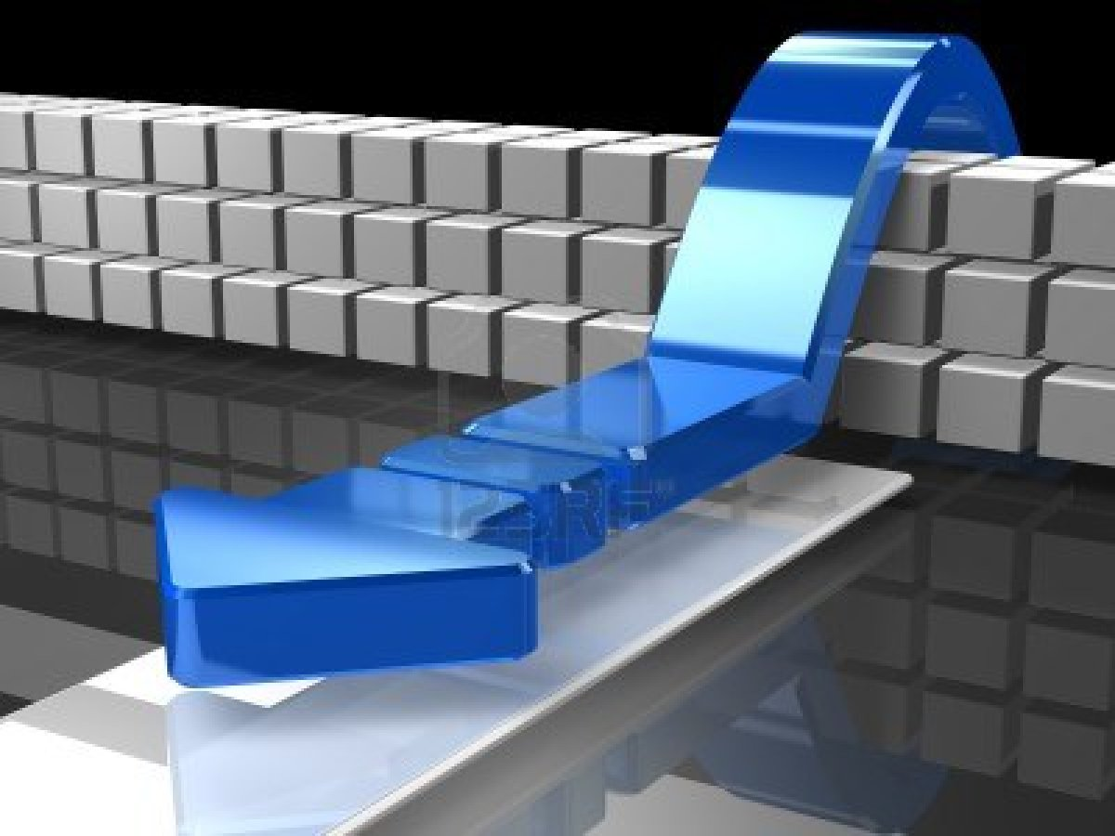
CONCLUSION

Slide 36
Ways To Overcome Barriers to Communication-
For Physical Barriers-
Appropriate Seating Arrangement
Ensure Visibility & Audibility
Environmental Comfort
Minimise Visual/Oral Distractions
For Semantic Barriers-
Use of Simple Language
Symbols & Charts
Active Listening/ Constructive feedback

Slide 37
Contd..
For Socio-Psychological Barriers-
Calling Attention & Motivation
Assistance & Sympathy
For Cross Cultural Barriers-
Understanding of Traditions & Customs
Information of all Sides of Culture

Slide 38
Contd..
For Organisational Barriers-
Simple Organisational Structure
Avoiding Information Overload
Flexibility in Meeting Targets

